Slide 1
Induction Handbook
Family and Community Learning

Slide 2
Family and Community Learning “Growing a lifelong love of learning with communities in Wiltshire.”
The Family and Community Learning
team are here to help you:
With your learning
With your skills development
With your next steps

Slide 3
Prevent – The Government Strategy designed to keep us safe from terrorism and from being drawn into extremism.
Prevent: An Introduction - YouTube
British Values – We follow these principles in all that we do.
ETF Documentary: British Values - YouTube
Safeguarding – We have four Designated Safeguarding Leads who are here to support you if you have any concerns about your own safety or the safety of others around you.
Online safety – Our Learning Platform and resources are carefully chosen with your safety in mind. We give you support and information to maintain this.
How We Keep You Safe

Slide 4
Don’t share personal details
Think before you post – once you post it, you lose control of it
Use a blurred or neutral background on your screen
Never share your password
Choose a strong, unique, hard to guess password
Keep your device secure – update when prompted
Look for the padlock on a website that shows information is secure
How To Stay Safe Online

Slide 5
Democracy – making decisions together and having your say
Rule of law – following rules to keep order and to keep everyone safe
Individual liberty – freedom to make your own choices and have your own thoughts and ideas
Mutual respect – understanding that everyone is entitled to share their own thoughts and ideas and being willing to listen
Tolerance – embracing the idea that we are all different, with different backgrounds, cultures and beliefs

Slide 6
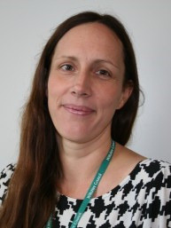
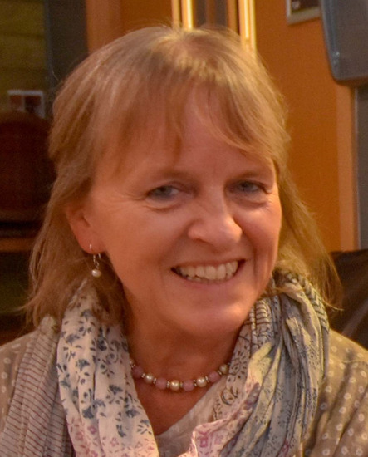
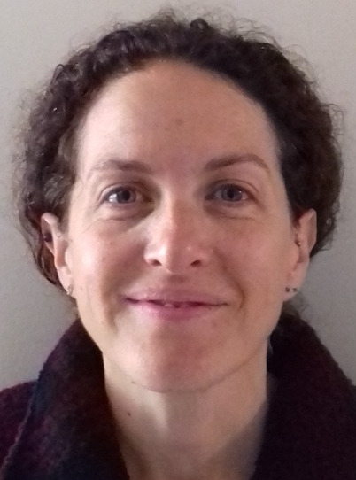
SAFEGUARDING: If you are feeling sad, upset, hurt, scared or worried, you can talk to any member of staff or one of the Safeguarding Team
Rowena Prentice
Designated Safeguarding Lead
01225 770 478
Laura Trowbridge
Designated Safeguarding Lead
07827 283 932
Lucinda Murray
Designated Safeguarding Lead
07768 926 662
Helen Edwards-Matheou
Designated Safeguarding Lead
07880 482 807

Slide 7
Save it!
Save or screenshot the message
Report it!
Through the provider: Facebook, WhatsApp etc.
To your internet/phone provider
To your tutor, for support
To the police, if serious enough
Forward texts to 7726
Forward scam emails to report@phishing.gov.uk
Check it!
Check suspicious phone numbers through your search engine
What To Do
If You See, Hear or Read Something Upsetting Online
(including scams and cyber bullying)

Slide 8
Your responsibilities as a learner:
Please participate in online classes – with cameras and microphones
Please notify your tutor if you cannot attend a session.
Please speak to your tutor if you need more time to complete learning activities at home.
Please complete your Learner Journey before session one and after each session.
Ask questions to support your learning, give us feedback, and enjoy your course!
Please read your tutor’s feedback to help you to see your progress, and your next steps.

Slide 9
Learner Journey – you and your tutor will add to these regularly. Feedback and questions and answers will be added here.
In the challenges and barriers box, think about what you might need help with. Do we need to send you reminders before each session, remind you to complete work, use the subtitles in teams, check that you are feeling ok etc.? If you don't tell us, we can't help.

Slide 10
Learner journey continued
We need to know how you feel about these areas and if there is anything we can help you to work on.
If you would like your mentor to call you, type that in here and we will organise a time to do so
What are your goals and aspirations? These could be big or small or some of each. You can add to these and change them. Feedback and advice and guidance will be added here by your tutor.

Slide 11
999 Emergency number
111 Non emergency Medical number
116 123 Samaritans, free phone number for mental health support
0300 456 0108 Child protection emergency number
0300 456 0100 Safeguarding emergency number
01225 770478 Family and Community Learning number
(office hours only)
101 Non emergency police number
Phone Numbers to Keep

Slide 12
Website: https://workwiltshire.co.uk/family-and-community-learning/
Facebook: https://www.facebook.com/Wiltsfamilylearning
ItsLearning link: itslearninglogin
Email: Familyandcommunitylearning@wiltshire.gov.uk
Family and Community Learning
Keep in touch

